Slide 1
بِسْمِ اللهِ الرَّحْمٰنِ الرَّحِيْم

Slide 2
Collision Detection & Warning System Based on AVR Platform
Microprocessor Systems & Interfacing [EEE342]
Semester Project
Irfan Danish [FA15-BEL-012]
Hammad Munir[FA15-BEL-034]

Slide 3
Contents:
Introduction
Background
AVR Platform
Ultrasonic Sensor
Working
Further Extension & Applications

Slide 4
Introduction:
Vehicles are an important way of transportation all over the world. There are many cases of road accidents every day in the world.
Timely detection of other vehicles on road is of extreme importance to help avoid accidents and potential loss of human life.
It propelled our concern on collision detection & warning system mainly for dense fog affected areas.

Slide 5
Background:
This system is an Arduino based collision detector.
This system enables vehicles to identify the chances of collision and gives visual or audio warning to the driver.
This project is about making cars more intelligent by issuing warnings and taking automatic action if necessary.

Slide 6
Arduino (AVR) Platform:
The Arduino Uno is a microcontroller board based on the AVR ATmega328.
It has 14 digital input/output pins & 6 analog inputs.
Arduino Uno comes with 16 MHz crystal oscillator.
It has 10 bit ADC(Analog to Digital Converter).

Slide 7
Ultrasonic Sensor:
The Ultrasonic sound waves has an extremely high pitch that humans cannot hear and is also free from external noises from passive or active sources.
This ultrasonic distance sensor (HC-SR04) provides steady and accurate distance measurements within the range of 2cm to 450cm.
It has a focus of less than 15 degrees and an accuracy of about 3mm.

Slide 8
Ultrasonic Sensor:
This particular sensor transmits an ultrasonic sound that has a frequency of about 40 kHz.
The sensor has two main parts- transducer that creates an ultrasonic sound wave while the other part listens to its echo.

Slide 9
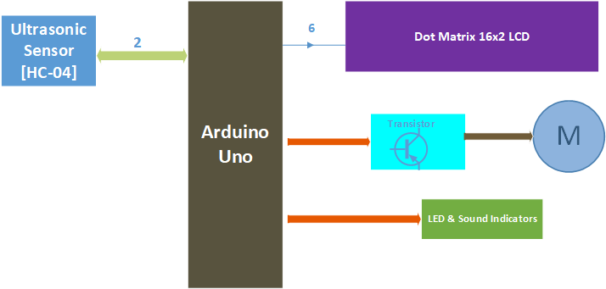
Working (Block Diagram):

Slide 10
Working:
The major contribution in this project is of the ultrasonic sensor module. It emits ultrasonic waves of 40 KHz from its trigger.
These waves hit any hindrance in its path and then echoes back to the receiver.

Slide 11
Working:
The time taken for the echo to return determines the distance of the hindrance that was created or occurred in the wave’s path.
We have programmed our controller in such a way that it will create three zones.
The respective distance from the object is displayed on LCD.

Slide 12
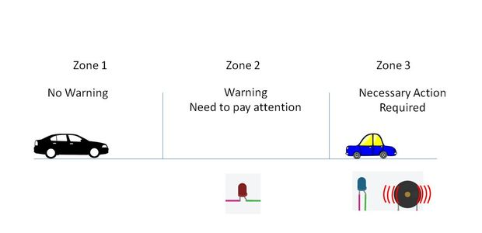
Zone 1:

Slide 13
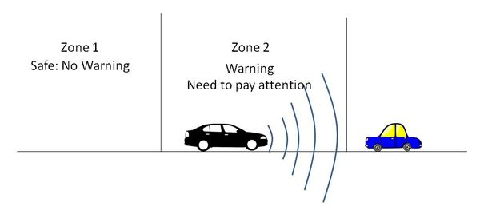
Zone 2:

Slide 14
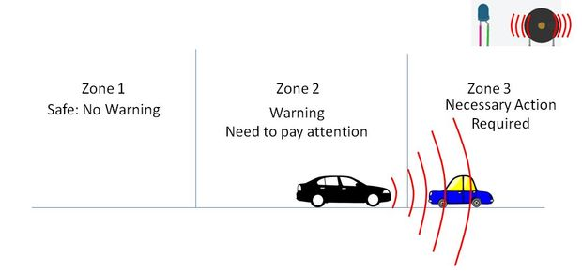
Zone 3:

Slide 15
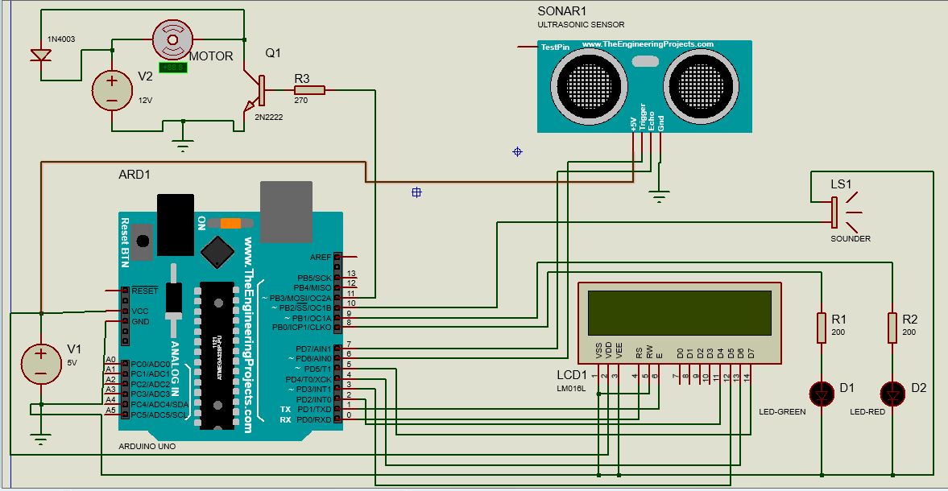
Working (Schematic):

Slide 16
Extensions & Applications:
By adding Wi-Fi (Controller Node MCU or Wi-Fi Module) and GPS Module we can send the location of collision to nearby police stations and to family of the person.
We can create blind stick using Ultrasonic Sensor & Arduino.
An automatic water level controller can be developed which can switch water pump by sensing water level in the tank.
It can also be used for counting persons in a particular space.

Slide 17
Thanks

